Slide 1





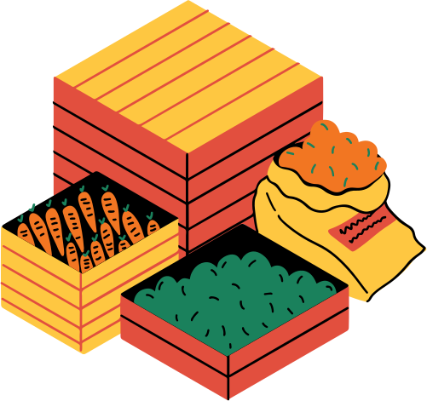



APRIORI ALGORITHM
APRIORI ALGORITHM
MARKET BASKET ANALYSIS
MARKET BASKET ANALYSIS

Slide 2


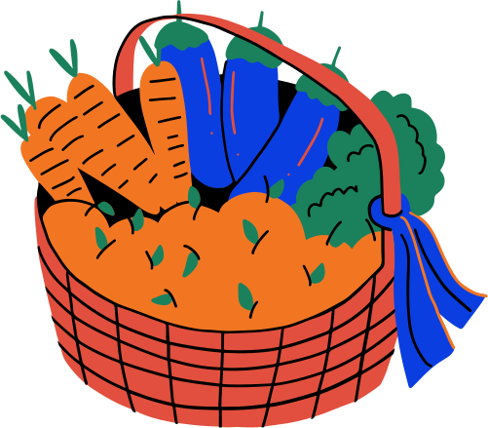

INTRODUCTION
The Apriori algorithm is a popular Data mining method used to find frequent itemsets and generate association rules.
It’s widely used in market basket analysis to uncover patterns like:
"Customers who buy bread often also buy butter."

Slide 3
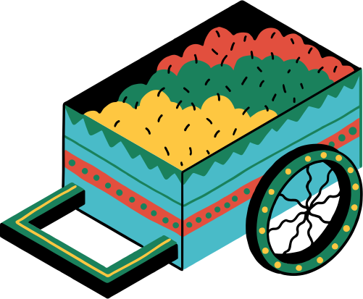


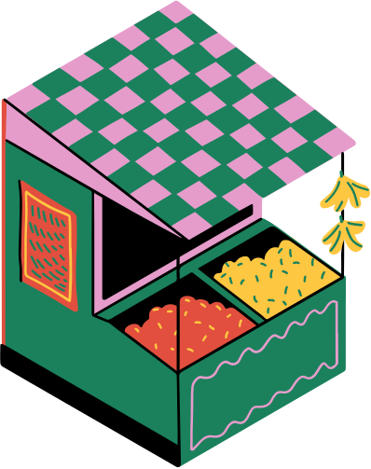



MARKET OF CONTENTS
2
How Apriori works
4
Results
1
What is Apriori Algorithm
3
The Dataset
& Visualiziation
5
Conclusion

Slide 4
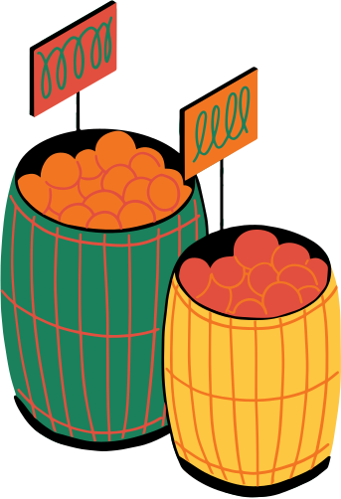
WHAT IS APRIORI ALGORITHM
Association Rule learning algorithm
All subsets of a frequent itemset must also be frequent
Key metrics
Transaction containing X
Support
Support (x) =
Total Transactions
Support (A U B)
Confidence
Confidence (A => B) =
Support( A )
Support (AUB)
Lift
Lift (A => B) =
Support (A) * Support (B)

Slide 5

HOW APRIORI ALGORITHM WORKS
Step 1 : Data preprocessing & One-Hot Encoding transaction formation
Transactions | Milk | Bread | Butter | Cookies
1 | 0 |  |  | 0
2 |  |  | 0 | 0
3 |  | 0 | 0
4 | 0 |  |  | 0
5
1
1
1
1
1
1
1
1
1
1
1
1

Slide 6

HOW APRIORI ALGORITHM WORKS
Step 2 : Generate frequent itemset
Transaction containing X
Support (x) =
Total Transactions
3
Support (Milk) =
=
0.6
5
4
Support (bread) =
= 0.8
5
Step 3 : Generate Association rules
A = {milk}, Rule: milk => {bread, butter}
A = {bread}, Rule: bread => {milk, butter}
A = {milk, bread}, Rule: {milk, bread} => butter

Slide 7
Support (x) =
Total Transactions
Transaction containing X
Support (x) =
Total Transactions
Transaction containing X
Support (x) =
Total Transactions
Transaction containing X
HOW APRIORI ALGORITHM WORKS
Step 3 : Calculate Rule Metrics
Transaction containing both A & B
Support (A =>B) =
Total Transactions
Support (A U B)
Confidence (x) =
Support (A)
Confidence (A => B)
Lift (A => B) =
Support(B)
P(A n B)
Jaccard Index =
P(A) + P(B) - P(AnB)
Certainity =
Confidence - Support (B)
Kulczynski =
1/2 (P(B|A) + P(A|B))

Slide 8
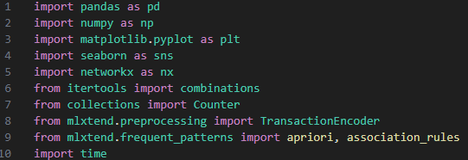
DATASET &VISUALIZATION
Source : Groceries_dataset.csv
Structure:
Member_number
Date
itemDescription
Visualization:
Bar Chart
Heatmap
Network Graph

Slide 9
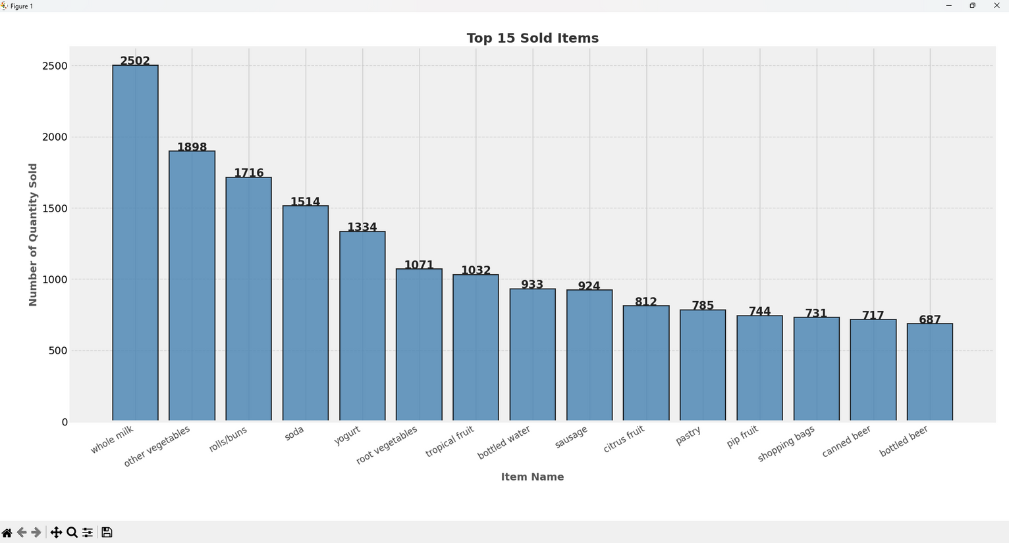
DATASET &VISUALIZATION
Bar Chart

Slide 10
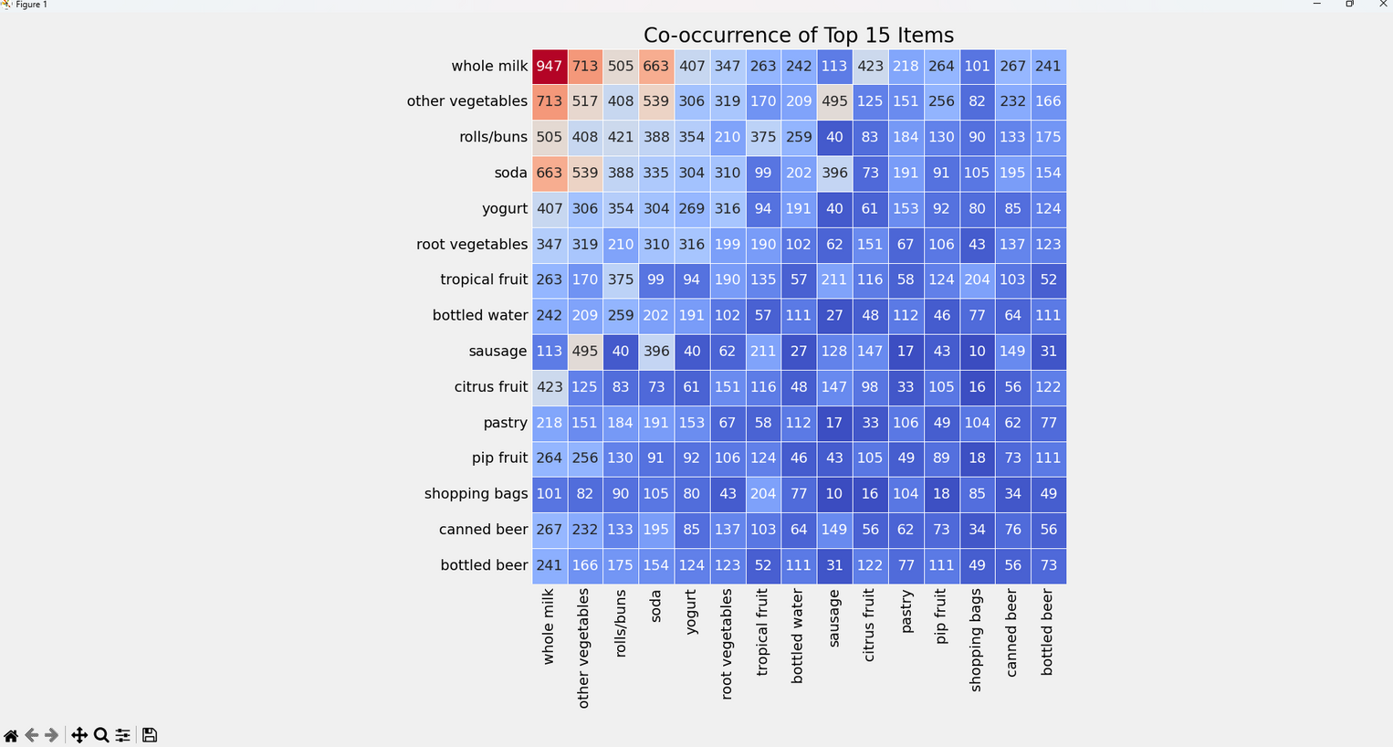
DATASET &VISUALIZATION
Heatmap

Slide 11
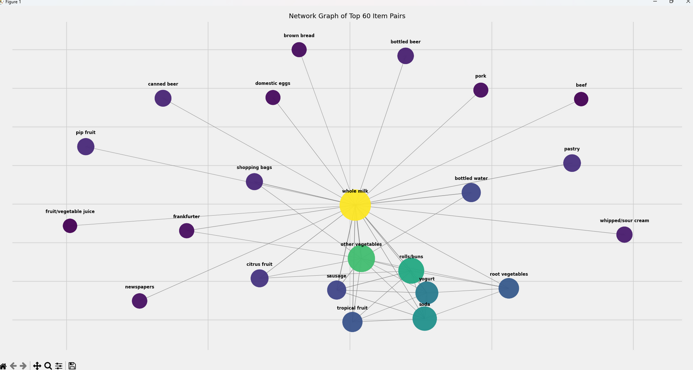
DATASET &VISUALIZATION
Network Graph

Slide 12
RESULTS
Antecedents | Consequent | Confidence | Lift
Sausage, Pork | Whole Milk | 39.1% | 2.48
Sweet spreads | pip fruit | 11.7% | 2.40
Yogurt | Sausage | 13.2% | 2.18
Outcomes :
Whole milk is a key product – it appears in many strong rules.
Sausage is often bought together with other proteins and milk.
Items like sweet spreads and pip fruits form niche but strong associations.

Slide 13
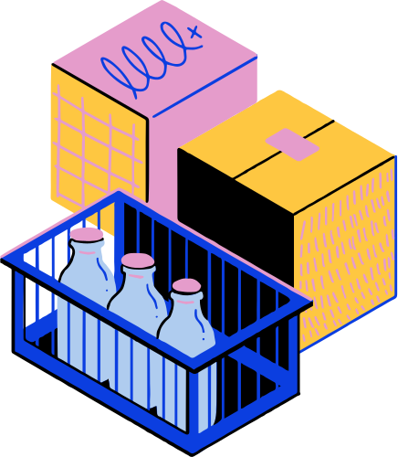

CONCLUSION
Benefits
Easy to understand and implement
Works well for market basket and transactional data
Helps identify product affinities (e.g., what items are bought together)
Benefits
Easy to understand and implement
Works well for market basket and transactional data
Helps identify product affinities (e.g., what items are bought together)
Limitations
Can be computationally expensive on large datasets
Requires setting proper support/confidence thresholds
Use Cases
Retail product placement and bundling
Fraud detection & web usage mining

Slide 14


THANK YOU
THANK YOU
SALE ON QUESTIONS

